Slide 1
Overview of HTML, CSS and JavaScript
Unit-1

Slide 2
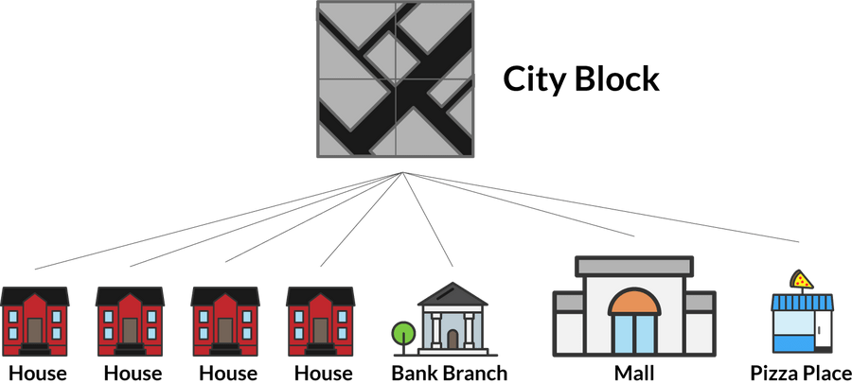
Understanding HTML, CSS and JavaScript
Let’s imagine that you are in charge of planning the layout of a new neighborhood in the city. This neighborhood will have some residential buildings, some eateries, a bank branch and a mall.

Slide 3
Understanding HTML, CSS and JavaScript
Each building actually has three parts you can change:
1. The structure of the building itself
2. The interior and exterior decoration of the building
3. The actual functions that visitors can perform in each building
This corresponds to the three different types of files that you can use in your first website.

Slide 4
Understanding HTML, CSS and JavaScript
An HTML file contains the structure of the page itself. It is like the structure of the building.
A CSS file contains the styling of the page. It allows you to change colors, positioning and more. It is like the design of the building. How a building should look like.
A JavaScript file determines the dynamic and interactive elements on the page. It determines what happens when users click, hover or type within certain elements. This is like the functionality of the building.

Slide 5
Lecture (1-2)
Fundamentals of HTML
Creating Style Sheet
CSS Box Model- Border properties,
Padding properties
Margin properties

Slide 6
Fundamentals of HTML
HTML stands for Hypertext Markup Language, and it is the most widely used language to write Web Pages.
1. Hypertext refers to the way in which Web pages (HTML documents) are linked together. Thus the link available on a webpage are called Hypertext.
2. Write HTML Using Notepad++ or sublime text or visual code studio.

Slide 7
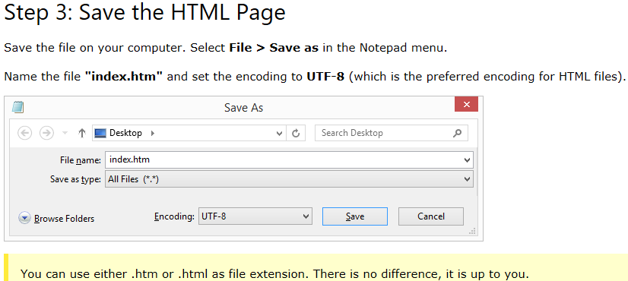
Fundamentals of HTML

Slide 8
Basic HTML Document Example
<!DOCTYPE html>
<html>
<head>
<title>This is document title</title>
</head>
<body>
<h1>This is a heading</h1>
<p>Document content goes here.....</p>
</body>
</html>

Slide 9
Basic HTML Document Example
The <!DOCTYPE html> declaration defines this document to be HTML5
The <html> element is the root element of an HTML page
The <head> element contains meta information about the document
The <title> element specifies a title for the document
The <body> element contains the visible page content
The <h1> element defines a large heading
The <p> element defines a paragraph

Slide 10
HTML Comment
An HTML comment begins with <!- - and the comment closes with - ->.
HTML comments are visible to anyone that views the page source code, but are not rendered when the HTML document is rendered by a browser.

Slide 11
HTML Tags
HTML is a markup language and makes use of various tags to format the content.
These tags are enclosed within angle braces <Tag Name>.
Except few tags, most of the tags have their corresponding closing tags.
For example <html> has its closing tag </html> and <body> tag has its closing tag </body> tag etc.

Slide 12
The <!DOCTYPE> Declaration
The <!DOCTYPE> declaration represents the document type, and helps browsers to display web pages correctly.
It must only appear once, at the top of the page (before any HTML tags).
The <!DOCTYPE> declaration is not case sensitive.
The <!DOCTYPE> declaration for HTML5 is:
<!DOCTYPE html>
HTML Basic Tags
1. Heading Tags
HTML has six levels of headings, which use the elements <h1>, <h2>, <h3>, <h4>, <h5>, and <h6>. While displaying any heading, browser adds one line before and one line after that heading.

Slide 13
Line Break Tag
Whenever you use the <br /> element, anything following it starts from the next line.
This tag is an example of an empty element, where you do not need opening and closing tags, as there is nothing to go in between them.
The <br /> tag has a space between the characters br and the forward slash

Slide 14
Note: If you omit this space, older browsers will have trouble rendering the line break, while if you miss the forward slash character and just use <br> it is not valid in XHTML
Example
<!DOCTYPE html>
<html>
<head>
<title>Line Break Example</title>
</head>
<body>
<p>Hello<br />
LPU<br />
Block -34<br />
CSE </p>
</body>
</html>

Slide 15
Centering Content
You can use <center> tag to put any content in the center of the page or any table cell.
Example
<!DOCTYPE html>
<html>
<head>
<title>Centring Content Example</title>
</head>
<body>
<p>Welcome to LPU</p>
<center><p>Welcome to School of CSE</p></center>
</body>
</html>

Slide 16
Paragraph Tag
The <p> tag offers a way to structure your text into different paragraphs. Each paragraph of text should go in between an opening <p> and a closing </p> tag as shown below in the example:
Example
<!DOCTYPE html>
<html>
<head>
<title>Paragraph Example</title><
/head>
<body>
<p>Here is a first paragraph of text.</p>
<p><h2>Here is a second paragraph of text.</h2></p>
<p>Here is a third paragraph of text.</p>
</body>
</html>

Slide 17
HTML Links
HTML links are defined with the <a> tag:
Example:
<a href="https://www.google.com">This is a link</a>
hypertext reference, HREF is an HTML attribute that is used either to link to another web page, or a different portion of the same page.

Slide 18
HTML Images
The <img> tag is used to embed an image on the HTML document.
The attributes are as follows:
src: The file path to the image file.
width: The width of the image, in pixels.
height: The height of the image, in pixels.
alt: The text the browser will display when visitors mouse over the image. Search engines often places more weight on the text in the alt attribute.

Slide 19
HTML Images example
<!DOCTYPE html>
<html>
<head>
<title>HTML Tag</title>
</head>
<body>
<img src ="webdesign.jpg" alt = "HTML Image" width="300" height="300" />
</body>
</html>

Slide 20
Horizontal Lines
Horizontal lines are used to visually break up sections of a document.
The <hr> tag creates a line from the current position in the document to the right margin and breaks the line accordingly.

Slide 21
For example you may want to give a line between two paragraphs as in the given example below:
Example
<!DOCTYPE html>
<html>
<head>
<title>Horizontal Line Example</title>
</head>
<body>
<p>This is paragraph one and should be on top</p>
<hr >
<p>This is paragraph two and should be at bottom</p>
</body>
</html>

Slide 22
Preserve Formatting
Sometimes you want your text to follow the exact format of how it is written in the HTML document. In those cases, you can use the preformatted tag <pre>.
Any text between the opening <pre> tag and the closing </pre> tag will preserve the formatting of the source document.

Slide 23
Example: Preserve Formatting
<!DOCTYPE html>
<html>
<body>
<pre>
Text in a pre element
is displayed in a fixed-width
font, and it preserves
both spaces and
line breaks
</pre>
</body>
</html>

Slide 24
Example: Preserve Formatting
<!DOCTYPE html>
<html>
<head>
<title>Preserve Formatting Example</title>
</head>
<body>
<pre>function testFunction( strText )
{
alert (strText)
}
</pre>
</body>
</html>

Slide 25
HTML Elements
An HTML element is defined by a starting tag. If the element contains other content, it ends with a closing tag, where the element name is preceded by a forward slash as shown below with few tags:
Start Tag Content End Tag
<p> This is paragraph content. </p>
<h1> This is heading content. </h1>
<div> This is division content. </div>
Note: There are some HTML elements which don't need to be closed, such as <img.../>, <hr /> and <br /> elements. These are known as void elements.
Notes:
<div class="myDiv">
<h2>This is a heading in a div element</h2>
<p>This is some text in a div element.</p>
</div>

Slide 26
HTML Attributes
An attribute is used to define the characteristics of an HTML element and is placed inside the element's opening tag. All attributes are made up of two parts: a name and a value:
The name is the property you want to set. For example, the paragraph <p> element in the example carries an attribute whose name is align, which you can use to indicate the alignment of paragraph on the page.
The value is what you want the value of the property to be set and always put within quotations. The below example shows three possible values of align attribute: left, center and right.

Slide 27
Example
<!DOCTYPE html>
<html>
<head>
<title>Align Attribute Example</title>
</head>
<body>
<p align="left">This is left aligned</p>
<p align="center">This is center aligned</p>
<p align="right">This is right aligned</p>
</body>
</html>

Slide 28
HTML Formatting Tags
Bold Text
Anything that appears within <b>...</b> element, is displayed in bold as shown below:
Example
<!DOCTYPE html>
<html>
<head>
<title>Bold Text Example</title>
</head>
<body>
<p>Welcome to <b>LPU</b> Jalandhar</p>
</body>
</html>

Slide 29
Italic Text
Anything that appears within <i>...</i> element is displayed in italicized as shown below:
Example
<!DOCTYPE html>
<html>
<head>
<title>Italic Text Example</title>
</head>
<body>
<p>Welcome to <i>LPU</i> Jalandhar</p>
</body>
</html>

Slide 30
Underlined Text
Anything that appears within <u>...</u> element, is displayed with underline as shown below:
Example
<!DOCTYPE html>
<html>
<head>
<title>Underlined Text Example</title>
</head>
<body>
<p>Welcome to <u>LPU</u> Jalandhar</p>
</body>
</html>

Slide 31
Strike Text
Anything that appears within <strike>...</strike> element is displayed with strikethrough, which is a thin line through the text as shown below:
Example
<!DOCTYPE html>
<html>
<head>
<title>Strike Text Example</title>
</head>
<body>
<p>This is completely <strike>bad</strike>idea</p>
</body>
</html>

Slide 32
Superscript Text
The content of a <sup>...</sup> element is written in superscript; the font size used is the same size as the characters surrounding it but is displayed half a character's height above the other characters.
Example
<!DOCTYPE html>
<html>
<head>
<title>Superscript Text Example</title>
</head>
<body>
<p>An example of <sup>superscript</sup> formatting tag</p>
</body>
</html>

Slide 33
Subscript Text
The content of a <sub>...</sub> element is written in subscript; the font size used is the same as the characters surrounding it, but is displayed half a character's height beneath the other characters.
Example
<!DOCTYPE html>
<html>
<head>
<title>Subscript Text Example</title>
</head>
<body>
<p>An example of <sub>subscript</sub> formatting tag</p>
</body>
</html>

Slide 34
Inserted and Deleted Text
Anything that appears within <ins>...</ins> element is displayed as inserted text.
Anything that appears within <del>...</del> element, is displayed as deleted text.
Example
<!DOCTYPE html>
<html>
<head>
<title>Inserted Text Example</title>
</head>
<body>
<p>This is an example of <del>HTML</del> and <ins>JavaScript</ins>
</p>
</body>
</html>

Slide 35
Larger Text
The content of the <big>...</big> element is displayed one font size larger than the rest of the text surrounding it as shown below:
Example
<!DOCTYPE html>
<html>
<head>
<title>Larger Text Example</title>
</head>
<body>
<p>Welcome to <big>LPU</big> Jalandhar</p>
</body>
</html>

Slide 36
Smaller Text
The content of the <small>...</small> element is displayed one font size smaller than the rest of the text surrounding it as shown below:
Example
<!DOCTYPE html>
<html>
<head>
<title>Smaller Text Example</title>
</head>
<body>
<p>Example of <small>small</small> formatting tag</p><
/body>
</html>

Slide 37
Grouping Content
The <div> and <span> elements allow you to group together several elements to create sections or subsections of a page.
Example
<!DOCTYPE html>
<html>
<head>
<title>Div Tag Example</title>
</head>
<body>
<div align="middle" >
<p> Welcome to HTML</p>
<p> Welcome to JavaScript</p>
<p> Welcome to CSS</p>
</div>
</body>
</html>

Slide 38
The <span> element, on the other hand, can be used to group inline elements only. So, if you have a part of a sentence or paragraph which you want to group together, you could use the <span> element as follows
Example
<!DOCTYPE html>
<html>
<head>
<title>Span Tag Example</title>
</head>
<body>
<p>This is the example of <span style="color:green">span tag</span> and the <span style="color:red">div tag</span> alongwith CSS</p>
</body>
</html>

Slide 39
Emphasized Text
Anything that appears within <em>...</em> element is displayed as emphasized text.
Example
<!DOCTYPE html>
<html>
<head>
<title>Emphasized Text Example</title>
</head>
<body>
<p>This is an example of <em>emphasized</em> tag</p>
</body>
</html>

Slide 40
Marked Text
Anything that appears with-in <mark>...</mark> element, is displayed as marked with yellow ink.
Example
<!DOCTYPE html>
<html>
<head>
<title>Marked Text Example</title>
</head>
<body>
<p>This is an example of <mark>marked</mark> tag</p>
</body>
</html>

Slide 41
Text Direction
The <bdo>...</bdo> element stands for Bi-Directional Override and it is used to override the current text direction.
Example
<!DOCTYPE html>
<html>
<head>
<title>Text Direction Example</title>
</head>
<body>
<p>This text will go left to right.</p>
<p><bdo dir="rtl">This text will go right to left.</bdo></p>
</body>
</html>

Slide 42
Short Quotations
The <q>...</q> element is used when you want to add a double quote within a sentence.
Example
<!DOCTYPE html>
<html>
<head>
<title>Double Quote Example</title>
</head>
<body>
<p>Welcome to <q>LPU</q>Jalandhar</p>
</body>
</html>

Slide 43
Computer Code
Any programming code to appear on a Web page should be placed inside <code>...</code> tags. Usually the content of the <code> element is presented in a monospaced font, just like the code in most programming books.
Example
<!DOCTYPE html>
<html>
<head>
<title>Computer Code Example</title>
</head>
<body>
<p>Regular text. <code>This is code.</code> Regular text.</p>
</body>
</html>

Slide 44
Core Attributes
The four core attributes that can be used on the majority of HTML elements are:
id
title
class
style

Slide 45
Core Attributes
The id Attribute
The id attribute of an HTML tag can be used to uniquely identify any element within an HTML page. There are two primary reasons that you might want to use an id attribute on an element:
1. If an element carries an id attribute as a unique identifier it is possible to identify just that element and its content.
2. If you have two elements of the same name within a Web page (or style sheet), you can use the id attribute to distinguish between elements that have the same name.

Slide 46
Example
<p id="html"> Simple HTML Text</p>
<p id="css">HTML with Cascading Style Sheet properties</p>
The title Attribute
The title attribute gives a suggested title for the element.
The behavior of this attribute will depend upon the element that carries it, although it is often displayed as a tooltip when cursor comes over the element or while the element is loading.
Example
<!DOCTYPE html>
<html>
<head>
<title>The title Attribute Example</title><
/head>
<body>
<h3 title="Hello HTML!">Titled Heading Tag Example</h3>
</body>
</html>

Slide 47
The class Attribute
The class attribute is used to associate an element with a style sheet, and specifies the class of element.
The value of the attribute may also be a space-separated list of class names. For example:
class="className1 className2 className3“
The style Attribute
The style attribute allows you to specify Cascading Style Sheet (CSS) rules within the element.
<!DOCTYPE html>
<html>
<head>
<title>The style Attribute</title>
</head>
<body><p style="font-family:arial; color:#FF0000;">Some text...</p>
</body>
</html>

